Slide 1
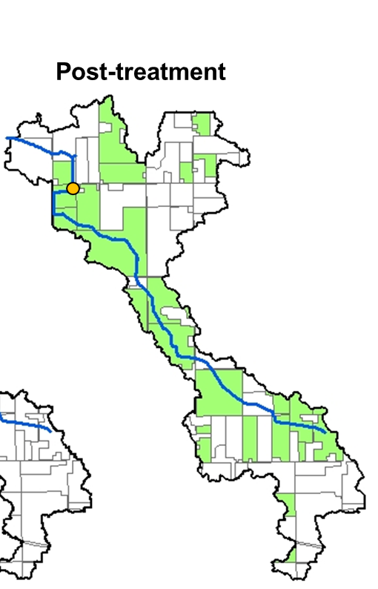

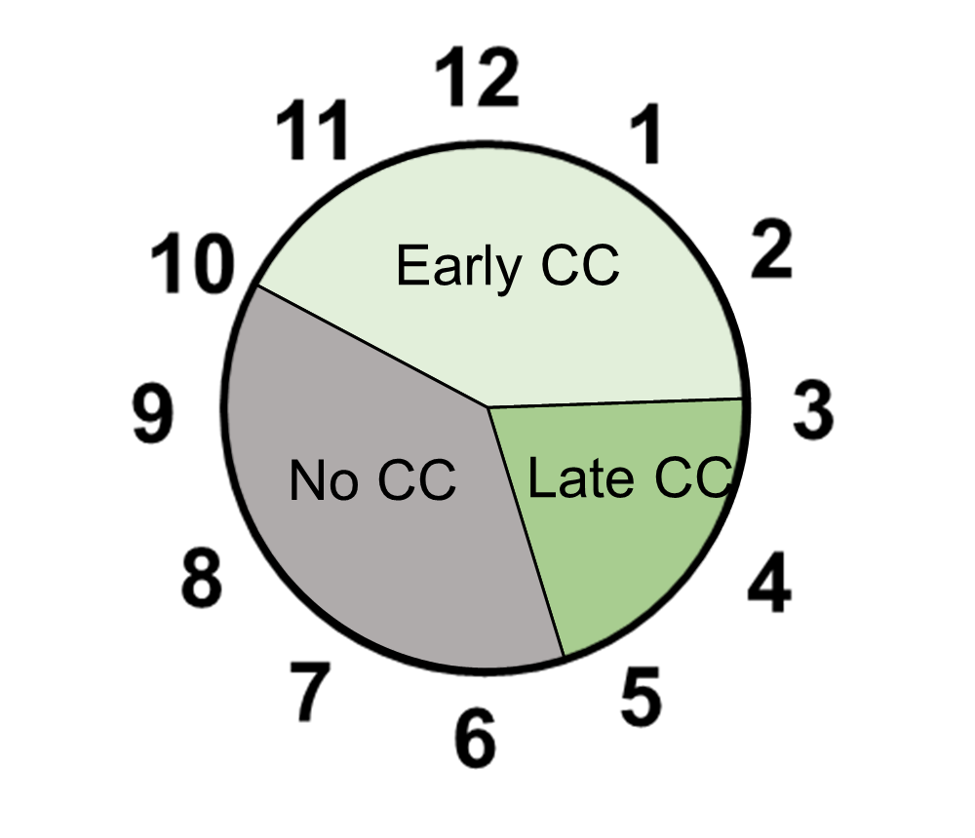
Months

Slide 2
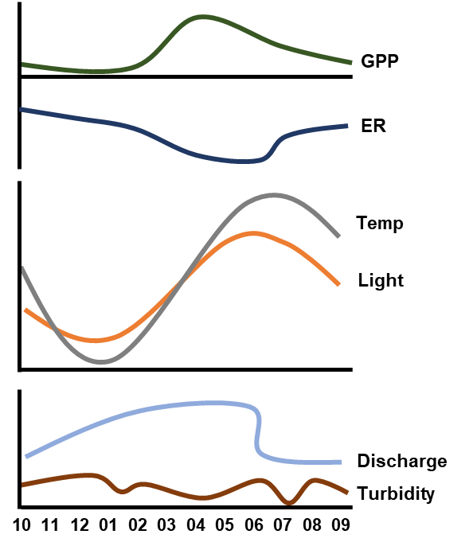
Primary controls relieved
Primary controls return
Primary controls limit GPP
GPP
ER
Primary
controls
Mediators
Month
Early CC
Late CC
No CC

